Slide 1
Introduction to the Goals Model in Spectrum
Assessing Program Impacts Using the Goals Model

Slide 2
Purpose of the Goals Model
To improve resource allocation for HIV/AIDS programs
What is the impact of scaling up prevention and treatment programs?
How much funding is required to reach our goals?
What is the effect of alternate allocation patterns?
What can we achieve with the available funding?
Recent Uses
Investment Cases
Fast-Track
90-90-90
Global strategies for condoms, VMMC, PrEP

Slide 3
Goals Model Applications
Main users
National program planners: NACP, Health Ministry
International organizations: UNAIDS, WHO (CHOICE)
Funders: Global Fund, PEPFAR, BM Gates Foundation
Researchers

Slide 4
Goals Model
Treatment
Pop Group
Faithful couples
Casual partnerships
Sex workers/clients
MSM
PWID
Behavior
# partners
Acts/partner
Condom use
Age at 1st sex
Needle sharing
Type of Transmission
Sex
Needle
Blood
MTCT
Probability of Transmission
New HIV Infections
Notes:
Goals divides the population into risk groups and uses information about the behavior of each group to estimate transmission. Two types of interventions can affect transmission. The bio-medical interventions (condoms, PrEP, MC, ART) directly affect the probability of transmission per act. The behavior change interventions affect the behaviors that lead to risk.

Slide 5
Goals Model
Treatment
Pop Group
Faithful couples
Casual partnerships
Sex workers/clients
MSM
PWID
Behavior
# partners
Acts/partner
Condom use
Age at 1st sex
Needle sharing
Type of Transmission
Sex
Needle
Blood
MTCT
Probability of Transmission
New HIV Infections
Coverage
Effectiveness
Biomedical
Condoms
Behavior Change
Communication
Outreach, Education
Community mobilization
Cash transfers
VMMC
ART
PMTCT
PrEP
Vaccines
Notes:
Goals divides the population into risk groups and uses information about the behavior of each group to estimate transmission. Two types of interventions can affect transmission. The bio-medical interventions (condoms, PrEP, MC, ART) directly affect the probability of transmission per act. The behavior change interventions affect the behaviors that lead to risk.

Slide 6
Goals Model
Treatment
Pop Group
Faithful couples
Casual partnerships
Sex workers/clients
MSM
PWID
Behavior
# partners
Acts/partner
Condom use
Age at 1st sex
Needle sharing
Type of Transmission
Sex
Needle
Blood
MTCT
Probability of Transmission
New HIV Infections
Coverage
Effectiveness
National HIV/AIDS Programs
Biomedical
Condoms
Behavior Change
Communication
Outreach, Education
Community mobilization
Cash transfers
VMMC
ART
PMTCT
Program Enablers
Policy / regulations
Strategic direction
Funding
PrEP
Vaccines
Communications
Management
Procurement
Research, M&E
Notes:
Goals divides the population into risk groups and uses information about the behavior of each group to estimate transmission. Two types of interventions can affect transmission. The bio-medical interventions (condoms, PrEP, MC, ART) directly affect the probability of transmission per act. The behavior change interventions affect the behaviors that lead to risk.

Slide 7








Spectrum Modules
AIM
Goals
RAPID
FamPlan
STI
Resource Needs
DemProj
Child Survival & Safe Motherhood
NCDs
Tuberculosis
OneHealth
Notes:
There are many other modules in Spectrum that can be used, as appropriate for each application. All of these modules are linked, so that they influence each other.

Slide 8
Spectrum: Goals and AIM
Demographic Data
AIM
Mother-to-child transmission
Child model
Adult model
Results
Number HIV+
New Infections
AIDS deaths
Need for ART
Need for PMTCT
Program Statistics
Epidemic Patterns
Behavioral Data
Goals
EPP
AEM
CSAVR
Incidence
Notes:
In preparing an HIV estimate the pattern of prevalence and incidence is generated by EPP. In a Goals application we use Goals to generate the incidence rather than EPP. Once Goals has calculated incidence, the rest of the calculations are the same as with the national estimate.

Slide 9
Risk Structure: Adults 15-49 by Sex
15 year olds
Not sexually active
Proportions allocated to each risk group can be fixed or include full or partial replacement
SW & clients
Non-regular partners
PWID
Stable couples
MSM
(LR, MR, HR, IDU/MSM)
Exit 15-49 population due to AIDS death, non-AIDS deaths, reaching age 50 or migrating out

Slide 10
Sexual Mixing
Males
SW clients
Males
Non-regular partners
Males
PWID
Males
Stable couple
Males
MSM
Females
Sex workers
Females
Non-regular partners
Females
PWID
Females
Stable couple

Slide 11
Sexual Mixing
Males
SW clients
Males
Non-regular partners
Males
PWID
Males
Stable couple
Males
MSM
Females
Sex workers
Females
Non-regular partners
Females
PWID
Females
Stable couple

Slide 12
Program and Behavioral Data Needed
Category of Data | Source
Population size | DemProj, UN Population Division
HIV program data (ART, PMTCT) | AIM
Epidemic dynamics (progression, mortality) | AIM
BY RISK GROUP
Population size | Surveys, population size studies (e.g., RDS) Global reviews: Aceijas, Caceres, Carael, Dagenhardt, Van de Pitte
Condom use | DHS/AIS, Key population surveys (e.g., IBBS)
Number of partners | Key population surveys
Acts per partner | Key population surveys, global defaults
Percentage ‘married’ | Surveys
Increased recruitment | Prevalence patterns
STI prevalence | Surveillance, studies
PWID: Proportion sharing needles | PWID surveys
Age at first sex | Demographic surveys
Notes:
Here are the data needed to implement Goals.

Slide 13
Determinants of risk of infection
Susceptible Partner
Infected Partner
HIV infection
Stage of infection
ART
Vaccination
Number of partners
Male circumcision
Oral PrEP
Topical PrEP
Vaccination
Number of acts per partner
STI prevalence
Heterosexual, MSM, IDU contact
Condom use
Notes:
The factors that determine the risk of transmission can be categorized as characteristics of the infected partner, the susceptible partner and the partnership.

Slide 14
Probability of Sexual Transmission
{1 – [P_{s’,g,t} x (1 - r_{s} x R_{g,t} x S_{g,t} x MC_{g,t} x C_{g,t} x Pr_{g,t} x A_{g,t} x V_{g,t})ª + (1 – P_{s’,g,t})]^{n} }
Vaccine
ART
PrEP use
Condom use Acts/partner Partners/yr
Male circumcision
STI prevalence
Stage of infection
Probability of transmission per act by sex and type of sex
Prevalence in partner
Where: MC, C, Pr, A, V = 1 – effectiveness x coverage
Notes:
Here is the full transmission equation. It expands on the one we saw earlier by adding the effect on the probability of transmission per act (r) of these other factors.

Slide 15
Parameter Ranges for Factors Affecting the Probability of Transmission
Parameter | Value | Source
Probability of transmission per act (F to M) | 0.001 (0.0008-0.0016) | Baggely et al., Gray et al.
Multiplier on per act transmission Male to female Presence of STI MSM contact | 1-1.5 2-11 2-4 | Baggely et al. Galvin and Cohen, Powers et al. Vittinghoff et al.
Relative infections by stage Primary infection Asymptomatic Symptomatic | 0.8-44 1 4-12 | Boily et al., Pinkerton et al., Blaser et al. Reference stage Boily et al.
Notes:
For each parameter in the transmission equation we have studies that define the range of values. When we fit the model to the historical epidemic, we search for the exact parameter values within these ranges that produce the best fit.

Slide 16
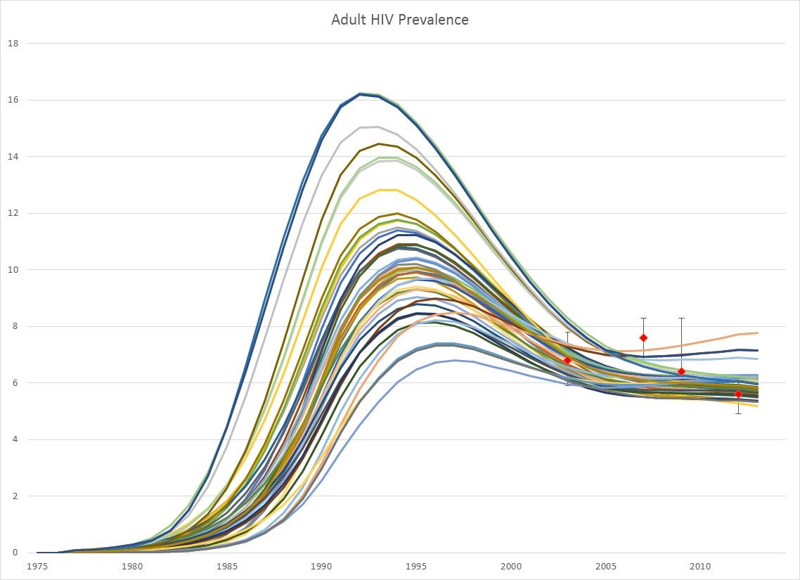
Fitting the model to historical trends
Parameters that can vary
R, prob of infection per act, f->m
Multipliers on r
M->f, STI, MSM, primary infection, symptomatic stage
Effectiveness of
ART, condom use, VMMC
Past trends in condom use and STI prevalence

Slide 17
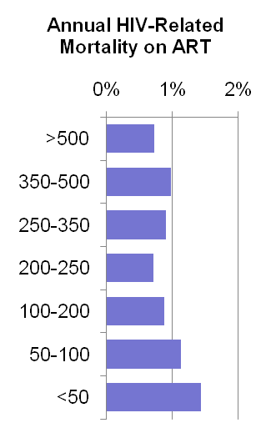
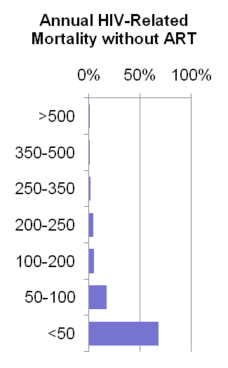
Adult CD4 Model by Risk Group
New Infections
>500
350-499
250-349
200-249
100-199
50-99
<50
On ART
μ
λ
c
α
>500
μ
λ
c
α
350-499
μ
λ
c
α
250-349
μ
λ
c
α
200-249
μ
λ
c
α
100-199
μ
λ
c
α
50-99
μ
λ
c
α
<50
Separate patterns for 0-6, 7-12 and 12+ months on ART
AIDS Death
Notes:
Once someone is newly infected, they are followed in the model by CD4 count. New infections usually start with high CD4 counts, >500 or 350-500. Each year several transitions are possible. A person could remain in the same CD4 category, they could die from a non-AIDS cause (not shown), they could die from AIDS, they could decline to a lower CD4 category, or they could get on ART.

Slide 18
Interventions that Impact HIV Transmission
Interventions Affecting the Probability of Transmission per Contact
Interventions Affecting Effectiveness and Efficiency
Interventions Affecting Behaviors
Male circumcision
PMTCT
ART
Condom use
PrEP
Needle and syringe exchange
Drug substitution
Vaccine
Tx adherence support
Viral load monitoring
Types of testing
Point of care testing
Task shifting
Community support
MC/PrEP counseling
Patient flow
Mass media
Community mobilization
Counseling and testing
Condom promotion
Key population outreach
School programs
Workplace prevention
Cash transfers
Notes:
Interventions may be broadly classified into these three categories.

Slide 19
Effectiveness
Intervention | Effectiveness | Source
ART | 75-85% | Based on viral suppression in SSA, McMahon et al. Viral suppression after 12 months of antiretroviral therapy in low- and middle-income countries: a systematic review Bull World Health Organ 2013.
VMMC | 51-64% | Auvert et al., Bailey et al., Gray et al.
Condoms | 83% (35-94%) | Weller S, Davis, K. Condom effectiveness in reducing heterosexual HIV transmission (Cochrane Review). In: The Cochrane Library, Issue 1, 2004. Chichester, UK: John Wiley & Sons, Ltd.
PMTCT | 55-98% | Rollins et al.
Needle and syringe exchange, opiod substitution therapy | 100% | No risk of transmission through contaminated needles
PrEP | 44-95% | iPrex, TDF2, Partners PrEP, Bangkok Tenofovir Study, PROUD, IPERGAY Trials show effectiveness depends on adherence. Effectiveness may be low initially but improve when injectable forms become available.
Cash transfers | 31-60% | Björkman-Nyqvist M et al., Baird SJ et al., De Walque et al.
Notes:
For the bio-medical interventions we have scientific studies that measure the effectiveness.

Slide 20
Hands-on session

Slide 21
Impact Matrix
Summarizes the research on the impact of behavior change interventions
Describes changes in behaviors (condom use, number of partners, age at first sex, needle sharing) within key populations of specific interventions
Intervention | FSW & Clients | Multiple Partners | Low Risk | MSM
Outreach | -30% |  |  | -25%
School-based |  | -20%
Testing | -10% | -30% | -10% | -15%
Community mobilization |  | -10% | -20% | -20%

Slide 22
Impact Matrix: Distribution of Studies
Type | Percent
Randomized control trial | 12%
Quasi-experimental | 16%
Longitudinal | 32%
Cross-sectional | 31%
Other | 8%
Region | Percent
Asia | 34%
Latin America | 12%
Sub-Saharan Africa | 41%
Eastern Europe | 4%
W Europe/US | 9%
Total = 230 studies
Bollinger LA, How do we calculate the “E” in “CEA”? AIDS 2008, 22 (suppl 1):S51-S57.
Bollinger L, et al. Grading Goals: a systematic review of studies in the Goals model. : AIDS 2010 - XVIII International AIDS Conference: Abstract no. WEPE0817
Notes:
The studies that inform the Impact Matrix are of various types and come from all regions,

Slide 23
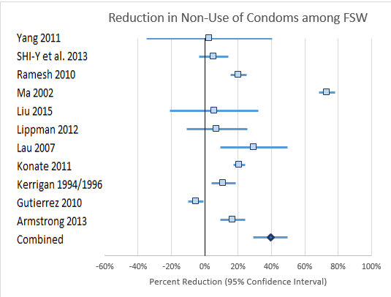
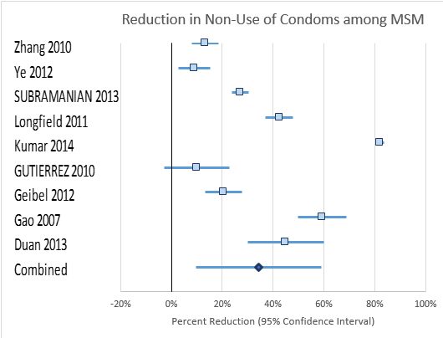
Meta-analysis of Intervention Impact

Slide 24
Impact Matrix: Condom Use (% Reduction in Non-Use of Condoms)
Intervention | Stable Couples | Multiple Partners | Sex Work | MSM | IDU
Mass media | -17 (1) | -12 (8)
VCT | -16 (8) | -23 (17) | -44 (3)
Community mobilization | -2.5 (3) | -10 (4)
Outreach |  |  | -42 (46) | -36 (8) | -18 (1)
School-based programs |  | -16 (13)
Programs for youth out-of-school |  | -17 (5)
Workplace programs | -1 (2) | -17 (6) | -39 (1)
Condom promotion | -5 (4) | -55 (7) | -85 (6)
Needle/syringe exchange |  |  |  |  | -41 (2)
Notes:
In order to estimate the impact of changes in coverage of behavior change interventions, we use the Impact Matrix, which is a summary of the impact literature findings. The figures shown are the median impact for each intervention. The numbers in parenthesis are the number of studies.
The Impact Matrix is a unique feature to Goals. Most simulation models would just directly enter condom use and number of partners. In Goals we calculate changes in these behaviors from increased coverage of behavior change interventions because that allows us to cost the interventions and link expenditure to impact.

Slide 25
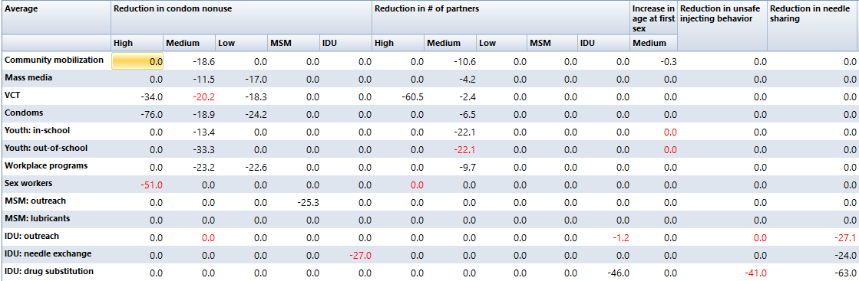
Impact of Behavior Change Interventions
Notes:
Here is an example of the full matrix which considers condoms use, number of partners, age at first sex, and unsafe injection.

Slide 26
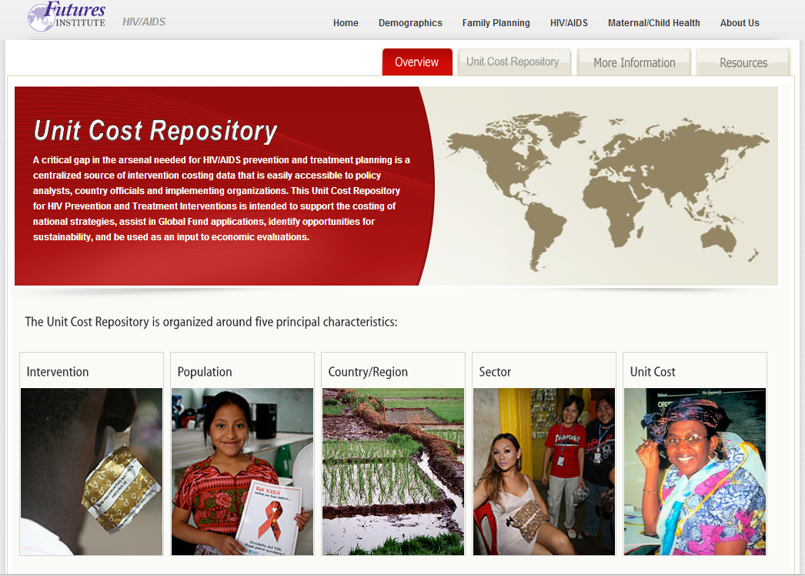
Costing
Sources of Information on Unit Costs
Unit cost data base developed by Avenir Health and LSHTM
Expert working group on costs of care and treatment
Investment Case analyses
PEPFAR expenditure analyses
Economies of scale
SW, MSM, PWID, transgenders, C&T, PMTCT
Country validation workshops for population sizes, unit costs, current coverage (33)
Africa, Caribbean, LA, Asia
Notes:
Unit costs are available from a variety of source, but it is surprising how many countries have very little unit cost data.

Slide 27
Future Costs of Treatment
Visits and Tests
Category | New | Stable | Unstable | PW
CD4 tests | 1 | 0 | 0
VL tests | 2 | 1 | 2
Blood chemistries | 1 | 1 | 1 | 1
Medical consultations | 4 | 1.16 | 3 | 6 1 EID
Delivery & adherence visits | 2 | 2 | 2
ARV costs: SSA
ARV cost | 2015 | 2020 | 2030
SSA | $145 | $116 | $104

Slide 28
Critical Enablers and Development Synergies
Impact on Behaviors
Program Support
Costed Programs
Other Synergies
HTC
Mass media
Community mobilization
School-based programs
Outreach to youth out-of-school
Workplace prevention
Communications
Management
Procurement
Distribution
Research
M&E
Social protection
Prevention of gender-based violence
Health services
Human rights
Poverty reduction
Legal reform
Gender equality
Notes:
Program support interventions are costs as a percentage add-on to the direct interventions costs.

Slide 29
Program Support
Program enablers
Management, HR, procurement, research, communications, community awareness
Social enablers
Community mobilization, policy, advocacy, legal reforms, stigma reduction, local action
Synergies
Education, social protection, health systems, workplace, poverty reduction
Source: Analysis of NASA data
Notes:
From the NASA we have some idea of how much is spent on these components. Current expenditure may not be ideal, however.

Slide 30
Key Output Indicators
Outputs
Impact
Investment Ratios
Number of people reached by intervention
Total costs by intervention
Infections averted
Deaths averted
QALYs gained
Net discounted cost
Per infection averted
Per death averted
Per DALY/QALY
Compare to benchmarks
Treatment savings
Productivity gains
Notes:
Key output indicators.

Slide 31
Uncertainty in Future Impact
Includes uncertainty in historical fit, intervention effectiveness and impact matrix

Slide 32
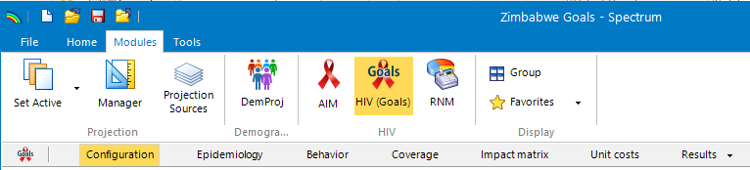
Updating your Goals File

Slide 33
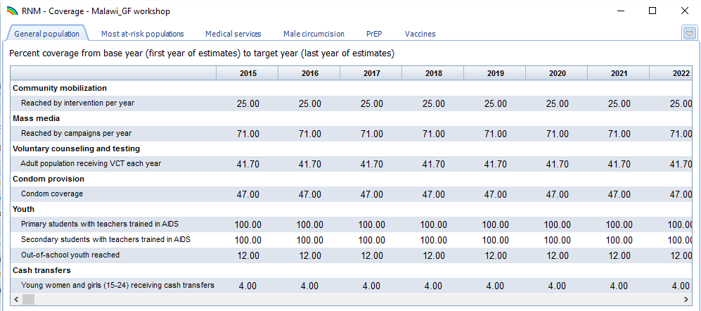
Review/revise coverage and unit cost data
Ctrl-D to duplicate from value across years
Ctrl-I to interpolate between 2015 and 2020

